Slide 1
Detection of Diagnosis of Breast Cancer Cells
Team 16
Chetana Parupalli
Yang Kyu Yoo

Slide 2
Breast Cancer
In the United States, about 1 in 8 women (~12%) will develop invasive breast cancer over the course of her lifetime.
Furthermore, the most common disease among women is breast cancer.
The best way to treat or prevent breast cancer is early diagnosis, so that the patient can get the treatment as early as possible. Therefore, machine learning can help diagnose breast cancer correctly and efficiently into malign and benign groups.
Question: How to distinguish between a Benign or Malignant Cancer cell?
Notes:
-Chetana (~ 1 minute)

Slide 3
Breast Cancer Wisconsin (Diagnostic) Data Set
Source - UCI Machine Learning Repository
Diagnostic Wisconsin Breast Cancer Database
This data set has 32 attributes. The features are computed from a digitized image of a fine-needle aspirate (FNA).
569 Instances
Notes:
-Yang

Slide 4
Data Selection
569 Instances (Class B = 357, Class M = 212)
32 Attributes
  1 id attribute
  1 diagnosis (B or M) attribute
  3 radius attributes (mean of distanced from center to points on the perimeter)
  3 texture attributes (standard deviation of gray scale values)
  3 perimeter attributes
  3 area attributes
  3 smoothness attributes (local variation in radius lengths)
  3 compactness attributes (perimeter^2/area - 1.0)
  3 concavity attributes (severity of concave portions of the contour)
  3 concave points attributes (number of concave portions of the contour)
  3 symmetry attributes
  3 fractal dimension attributes (“coastline approximation” - 1)
Notes:
-Yang (~1 minute)

Slide 5
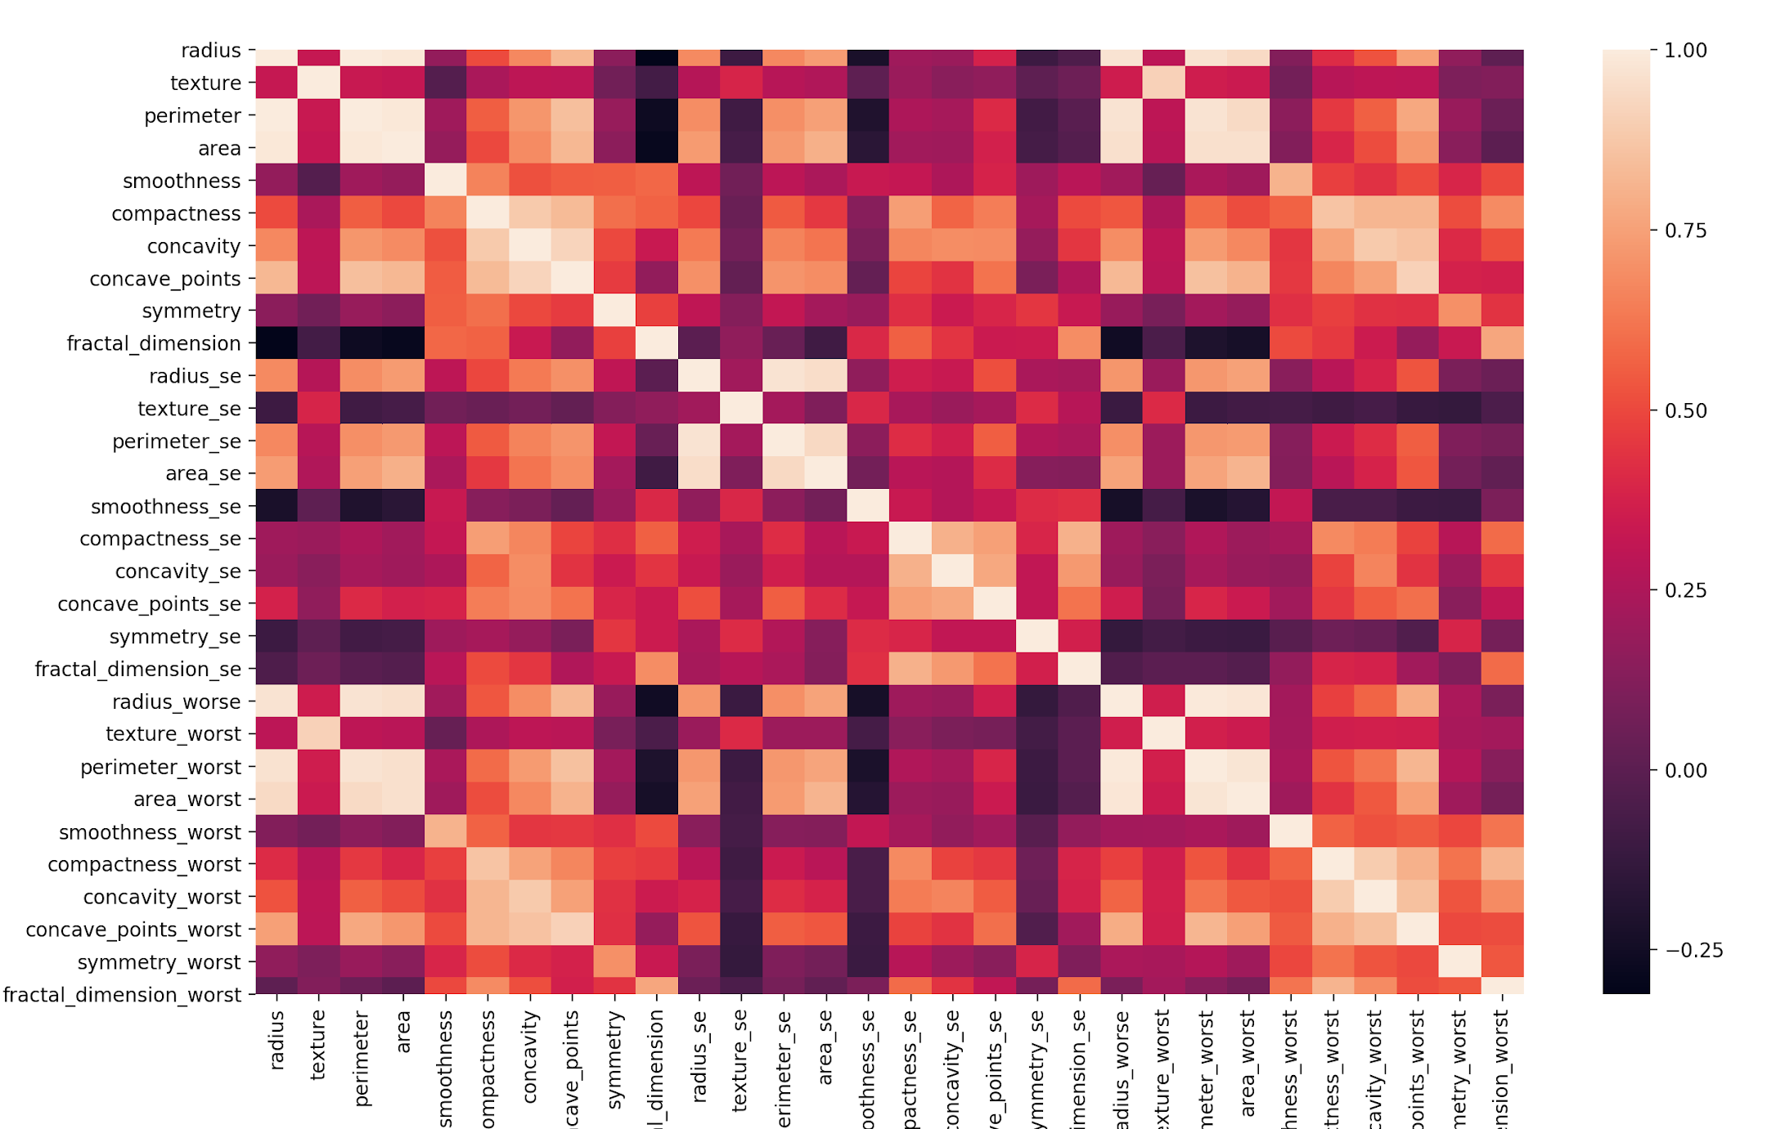
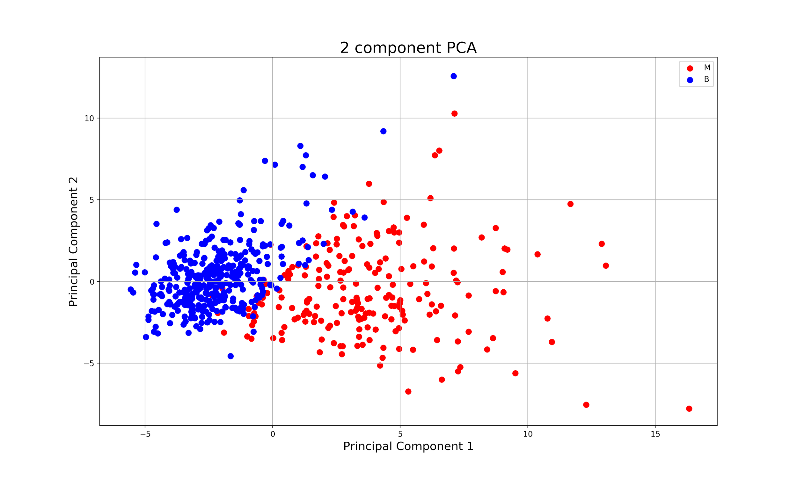
Preprocessing
Normalized data (x-μ)/σ
Created a correlation matrix and removed attributes with correlation greater than abs(0.98)
  Removed 4 attributes: perimeter, perimeter_worst, area, area_worst
Principal Component Analysis
  2 components that contained 63% variance of the entire dataset
Notes:
-Chetana (~2 minutes)

Slide 6
Data Mining
Tools used
Various Sklearn packages, Python IDE, Google Colab,
Classifiers
  Decision Tree
  Fast Frugal Tree
  Random Forest Classifier
  Neural Network (Dense Layer) Model
  Support Vector Machine
Notes:
-Yang (~30 seconds)

Slide 7
Result: K-Fold and Bootstrap
K-Fold (10) Cross Validation
0.632 Bootstrap approach
K-Fold | DT | RFT | FT | NN | SVM
Avg Accuracy | 96% | 98% | 96% | 89% | 89%
Bootstrap | DT | RFT | FT | NN | SVM
Avg Error Rate | 0.47 | 0.43 | 0.07 | 0.364 | 0.343
Notes:
-Chetana
-Talk about how random forest tree is good
-why is bootstrap error high?

Slide 8
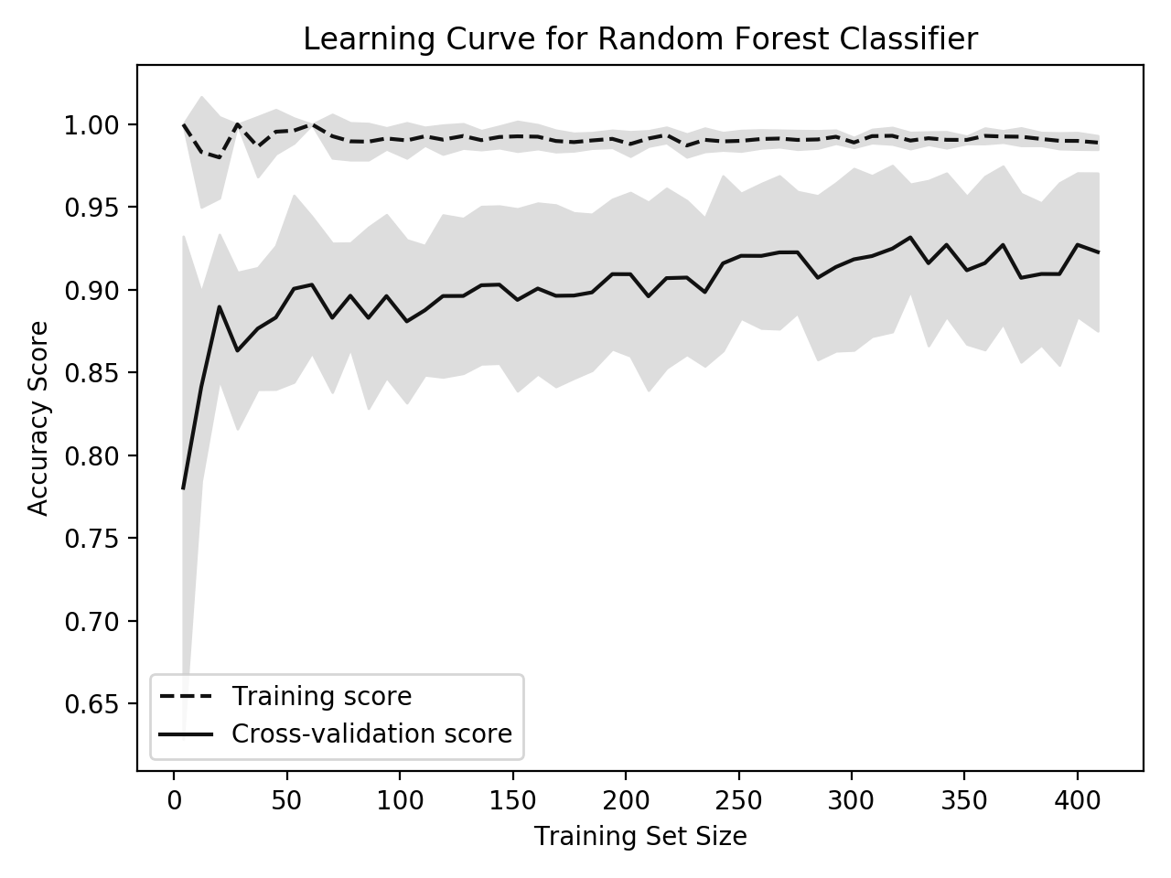
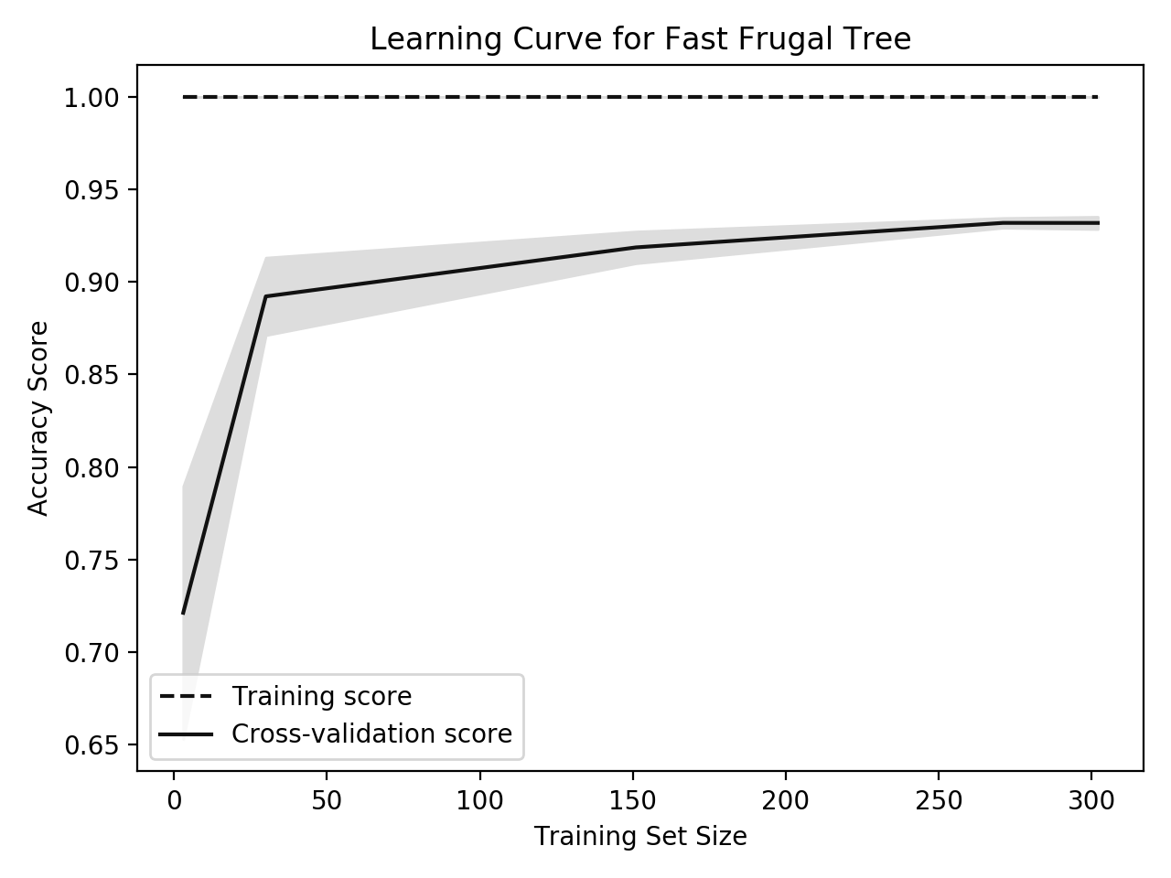
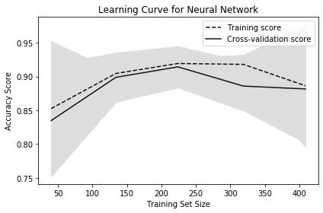
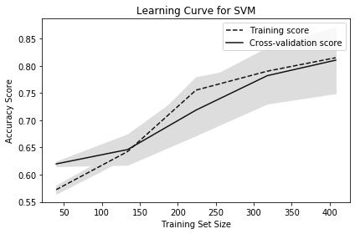
Result: Learning Curves
Notes:
-Yang
How accuracy increases (decrease) as training size goes up.

Slide 9
Results
 | DT | RFT | FT | NN | SVM
Accuracy | 96% | 98% | 96% | 91% | 89%
Notes:
-add precision and recall

Slide 10
Results : overall analysis
Decision Tree
Too complex with many branches and nodes
Frugal Tree
Too simple with not many levels leading to classification
Neural Network
Slow performance prevents various testings.
Unexplained behavior of network makes hard to determine proper network structure.
Support Vector Machine
Several key parameters that needed to be set correctly to achieve the best classification results - Kernel type and SVM type
Notes:
-Chetana
-Yang

Slide 11
Results
Performance
Random Forest performed the best with 98% accuracy.
Why?
Versatile
Great with high dimensionality
Quick training/testing speed
Handles outliers
Low bias
Notes:
-Chetana

